Slide 1

CS 533 INTRO TO DATA SCIENCE
Michael Ekstrand

Slide 2
CONCEPT AND DATA DRIFT

Slide 3

Learning Outcomes
Know crucial assumptions of machine learning evaluation and deployment
Understand how models can degrade over time
Photo by guille pozzi on Unsplash

Slide 4
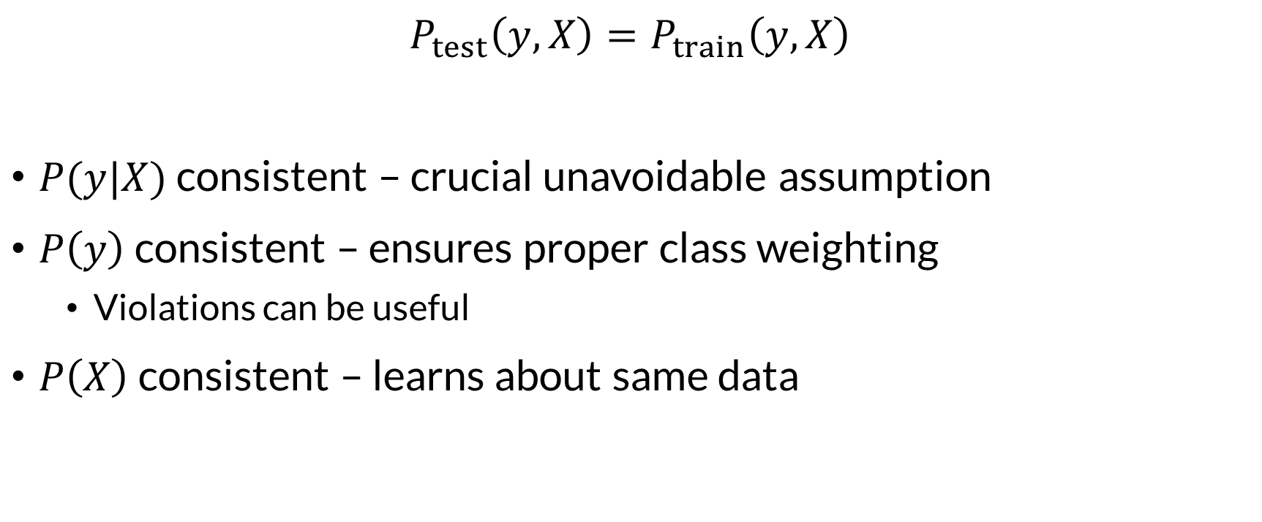
Fundamental Assumption
$$P_{test}\left(y,X\right)=P_{train}\left(y,X\right)$$
$P(y|X)$ consistent – crucial unavoidable assumption
$P\left(y\right)$ consistent – ensures proper class weighting
Violations can be useful
$P\left(X\right)$ consistent – learns about same data

Slide 5


Deployment Assumption
$$P_{live}\left(y,X\right)=P_{test}\left(y,X\right)$$
Test data reflects what we will see in deployment
If not, we haven’t really evaluated deployment performance!

Slide 6
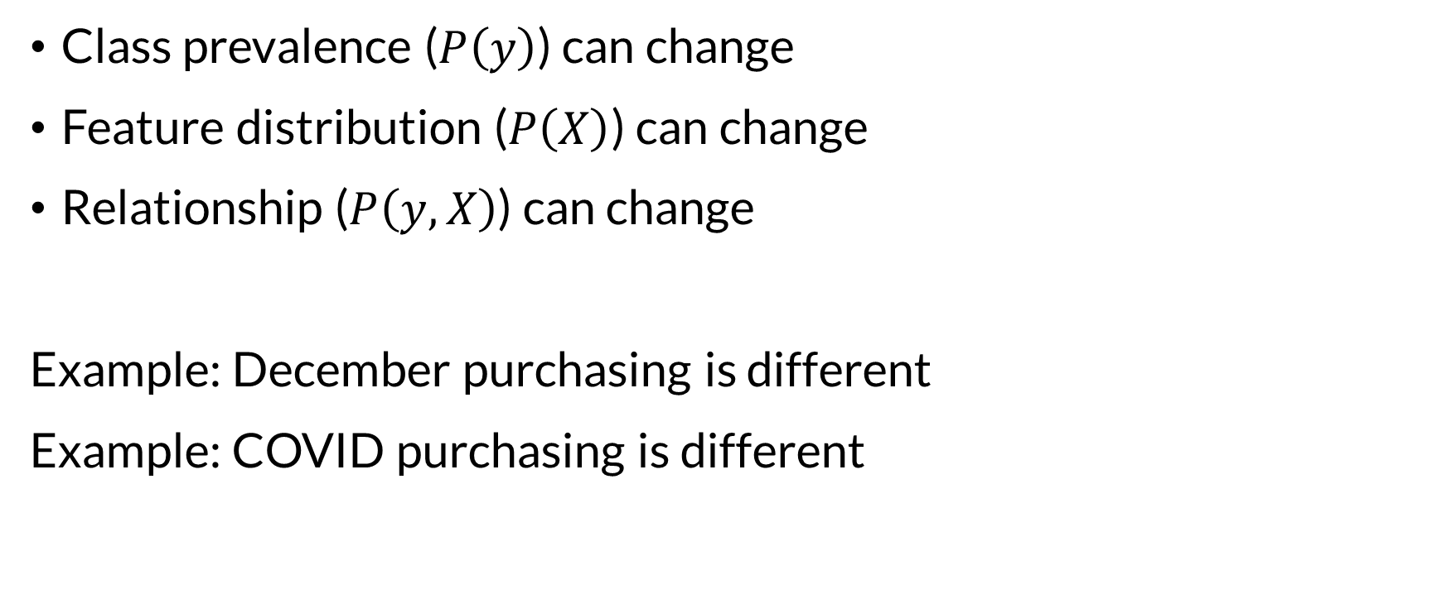
Drifts and Shifts
Class prevalence ($P\left(y\right)$) can change
Feature distribution ($P\left(X\right)$) can change
Relationship ($P\left(y,X\right)$) can change
Example: December purchasing is different
Example: COVID purchasing is different

Slide 7
Offline Solution: Temporal Splitting
Random train-test split ensures train/test comparable
Assumes test is uniformly drawn from same distribution!
Alternative: temporal split
Select temporally-contiguous test data (e.g. 1 month)
Train on data before test data (no time travel!)
Benefit: simulates actual use
Drawback: temporal data no longer random, inference harder

Slide 8
Online Solution: Continuous Monitoring
Instrument your system in production
Watch key metrics over time
Click-through rate
Classification rate
Regularly re-train and re-evaluate
Train model on new data
Evaluate model on new data

Slide 9

Wrapping Up
ML training and evaluation assumes that the training and test data match real life.
You can’t always rely on that.
Photo by Jackson Douglas on Unsplash

